Slide 1
Introduction
High Performance Computing
Anant V. Nimkar
Associate Professor
Dept. of Computer Engg.,
Sardar Patel Institute of Technology Mumbai

Slide 2
Chapter 2: Program and Network Properties
Conditions of parallelism
Program partitioning and scheduling
Program flow mechanisms
System interconnect architectures
EENG-630 - Chapter 2

Slide 3
Conditions of Parallelism
The exploitation of parallelism in computing requires understanding the basic theory associated with it. Progress is needed in several areas:
  computation models for parallel computing
  Inter-processor communication in parallel architectures
  integration of parallel systems into general environments
EENG-630 - Chapter 2

Slide 4



Data dependences
The ordering relationship between statements is indicated by the data dependence.
Flow dependence
Anti dependence
Output dependence
I/O dependence
Unknown dependence
EENG-630 - Chapter 2

Slide 5
Data Dependence - 1
Flow dependence: S1 precedes S2, and at least one output of S1 is input to S2.
Antidependence: S1 precedes S2, and the output of S2 overlaps the input to S1.
Output dependence: S1 and S2 write to the same output variable.
I/O dependence: two I/O statements (read/write) reference the same variable, and/or the same file.

Slide 6
Data Dependence - 2
Unknown dependence:
  The subscript of a variable is itself subscripted.
  The subscript does not contain the loop index variable.
  A variable appears more than once with subscripts having different coefficients of the loop variable (that is, different functions of the loop variable).
  The subscript is nonlinear in the loop index variable.
Parallel execution of program segments which do not have total data independence can produce non-deterministic results.

Slide 7
Data dependence example
S1: Load R1, A
S2: Add R2, R1
S3: Move R1, R3
S4: Store B, R1
S1
S2
S4
S3
EENG-630 - Chapter 2

Slide 8
I/O dependence example
S1: Read (4), A(I)
S2: Rewind (4)
S3: Write (4), B(I)
S4: Rewind (4)
S1
I/O
S3
EENG-630 - Chapter 2

Slide 9
Control dependence
The order of execution of statements cannot be determined before run time
  Conditional branches
  Successive operations of a looping procedure
EENG-630 - Chapter 2

Slide 10
Control dependence examples
Do 20 I = 1, N
A(I) = C(I)
IF(A(I) .LT. 0) A(I)=1
20 Continue
Do 10 I = 1, N
IF(A(I-1) .EQ. 0) A(I)=0
10 Continue
EENG-630 - Chapter 2

Slide 11
Resource dependence
Concerned with the conflicts in using shared resources
  Integer units
  Floating-point units
  Registers
  Memory areas
  ALU
  Workplace storage
EENG-630 - Chapter 2

Slide 12
Bernstein’s conditions
Set of conditions for two processes to execute in parallel
  I₁ ∩ O₂ = Ø
  I₂ ∩ O₁ = Ø
  O₁ ∩ O₂ = Ø
EENG-630 - Chapter 2

Slide 13
Bernstein’s Conditions - 2
In terms of data dependencies, Bernstein’s conditions imply that two processes can execute in parallel if they are flow-independent, antiindependent, and output-independent.
The parallelism relation || is commutative (P_{i} || P_{j} implies P_{j} || P_{i} ), but not transitive (P_{i} || P_{j} and P_{j} || P_{k} does not imply P_{i} || P_{k} ) . Therefore, || is not an equivalence relation.
Intersection of the input sets is allowed.

Slide 14
Utilizing Bernstein’s conditions
P₁ : C = D x E
P₂ : M = G + C
P₃ : A = B + C
P₄ : C = L + M
P₅ : F = G / E
P1
P2
P4
P3
P5
EENG-630 - Chapter 2

Slide 15
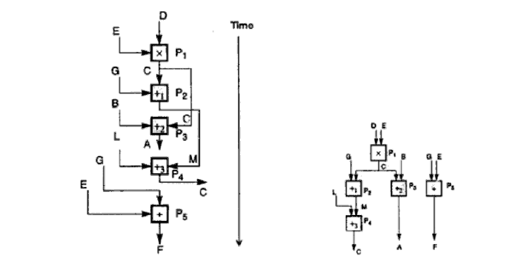
Utilizing Bernstein’s conditions

Slide 16
Hardware parallelism
A function of cost and performance tradeoffs
Displays the resource utilization patterns of simultaneously executable operations
Denote the number of instruction issues per machine cycle: k-issue processor
A multiprocessor system with n k-issue processors should be able to handle a maximum number of nk threads of instructions simultaneously
EENG-630 - Chapter 2

Slide 17
Software parallelism
Defined by the control and data dependence of programs
A function of algorithm, programming style, and compiler organization
The program flow graph displays the patterns of simultaneously executable operations
EENG-630 - Chapter 2

Slide 18
Mismatch between software and hardware parallelism - 1
Cycle 1
L₁
L₂
L₃
L₄
Maximum software parallelism (L=load, X/+/- = arithmetic).
Cycle 2
X₁
X₂
Cycle 3
+
-
A
B

Slide 19
Mismatch between software and hardware parallelism - 2
L₁
Cycle 1
Same problem, but considering the parallelism on a two-issue superscalar processor.
L₂
Cycle 2
X₁
L₃
Cycle 3
L₄
Cycle 4
X₂
Cycle 5
+
Cycle 6
-
Cycle 7
A
B

Slide 20
Mismatch between software and hardware parallelism - 3
L₁
L₃
Cycle 1
L₂
L₄
Cycle 2
Same problem, with two single-issue processors
X₁
X₂
Cycle 3
S₁
S₂
Cycle 4
L₅
L₆
Cycle 5
= inserted for synchronization
+
-
Cycle 6
A
B

Slide 21
Software parallelism
Control parallelism – allows two or more operations to be performed concurrently
  Pipelining, multiple functional units
Data parallelism – almost the same operation is performed over many data elements by many processors concurrently
  Code is easier to write and debug
EENG-630 - Chapter 2

Slide 22
Types of Software Parallelism
Control Parallelism – two or more operations can be performed simultaneously. This can be detected by a compiler, or a programmer can explicitly indicate control parallelism by using special language constructs or dividing a program into multiple processes.
Data parallelism – multiple data elements have the same operations applied to them at the same time. This offers the highest potential for concurrency (in SIMD and MIMD modes). Synchronization in SIMD machines handled by hardware.

Slide 23
Solving the Mismatch Problems
Develop compilation support
Redesign hardware for more efficient exploitation by compilers
Use large register files and sustained instruction pipelining.
Have the compiler fill the branch and load delay slots in code generated for RISC processors.

Slide 24
The Role of Compilers
Compilers used to exploit hardware features to improve performance.
Interaction between compiler and architecture design is a necessity in modern computer development.
It is not necessarily the case that more software parallelism will improve performance in conventional scalar processors.
The hardware and compiler should be designed at the same time.

Slide 25
Program Partitioning & Scheduling
The size of the parts or pieces of a program that can be considered for parallel execution can vary.
The sizes are roughly classified using the term “granule size,” or simply “granularity.”
The simplest measure, for example, is the number of instructions in a program part.
Grain sizes are usually described as fine, medium or coarse, depending on the level of parallelism involved.

Slide 26
Latency
Latency is the time required for communication between different subsystems in a computer.
Memory latency, for example, is the time required by a processor to access memory.
Synchronization latency is the time required for two processes to synchronize their execution.
Computational granularity and communicatoin latency are closely related.

Slide 27
Levels of Parallelism
}
Jobs or programs
Increasing communication demand and scheduling overhead
Higher degree of parallelism
Coarse grain
Subprograms, job steps or
related parts of a program
}
Medium grain
Procedures, subroutines,
tasks, or coroutines
}
Non-recursive loops
or unfolded iterations
Fine grain
Instructions
or statements

Slide 28
Instruction Level Parallelism
This fine-grained, or smallest granularity level typically involves less than 20 instructions per grain. The number of candidates for parallel execution varies from 2 to thousands, with about five instructions or statements (on the average) being the average level of parallelism.
Advantages:
  There are usually many candidates for parallel execution
  Compilers can usually do a reasonable job of finding this parallelism

Slide 29
Loop-level Parallelism
Typical loop has less than 500 instructions.
If a loop operation is independent between iterations, it can be handled by a pipeline, or by a SIMD machine.
Most optimized program construct to execute on a parallel or vector machine
Some loops (e.g. recursive) are difficult to handle.
Loop-level parallelism is still considered fine grain computation.

Slide 30
Procedure-level Parallelism
Medium-sized grain; usually less than 2000 instructions.
Detection of parallelism is more difficult than with smaller grains; interprocedural dependence analysis is difficult and history-sensitive.
Communication requirement less than instruction-level
SPMD (single procedure multiple data) is a special case
Multitasking belongs to this level.

Slide 31
Subprogram-level Parallelism
Job step level; grain typically has thousands of instructions; medium- or coarse-grain level.
Job steps can overlap across different jobs.
Multiprograming conducted at this level
No compilers available to exploit medium- or coarse-grain parallelism at present.

Slide 32
Job or Program-Level Parallelism
Corresponds to execution of essentially independent jobs or programs on a parallel computer.
This is practical for a machine with a small number of powerful processors, but impractical for a machine with a large number of simple processors (since each processor would take too long to process a single job).

Slide 33
Communication Latency
Balancing granularity and latency can yield better performance.
Various latencies attributed to machine architecture, technology, and communication patterns used.
Latency imposes a limiting factor on machine scalability. Ex. Memory latency increases as memory capacity increases, limiting the amount of memory that can be used with a given tolerance for communication latency.

Slide 34
Interprocessor Communication Latency
Needs to be minimized by system designer
Affected by signal delays and communication patterns
Ex. n communicating tasks may require n (n - 1)/2 communication links, and the complexity grows quadratically, effectively limiting the number of processors in the system.

Slide 35
Communication Patterns
Determined by algorithms used and architectural support provided
Patterns include
  permutations
  broadcast
  multicast
  conference
Tradeoffs often exist between granularity of parallelism and communication demand.

Slide 36
Grain Packing and Scheduling
Two questions:
  How can I partition a program into parallel “pieces” to yield the shortest execution time?
  What is the optimal size of parallel grains?
There is an obvious tradeoff between the time spent scheduling and synchronizing parallel grains and the speedup obtained by parallel execution.
One approach to the problem is called “grain packing.”

Slide 37
Program Graphs and Packing
A program graph is similar to a dependence graph
  Nodes = { (n,s) }, where n = node name, s = size (larger s = larger grain size).
  Edges = { (v,d) }, where v = variable being “communicated,” and d = communication delay.
Packing two (or more) nodes produces a node with a larger grain size and possibly more edges to other nodes.
Packing is done to eliminate unnecessary communication delays or reduce overall scheduling overhead.

Slide 38
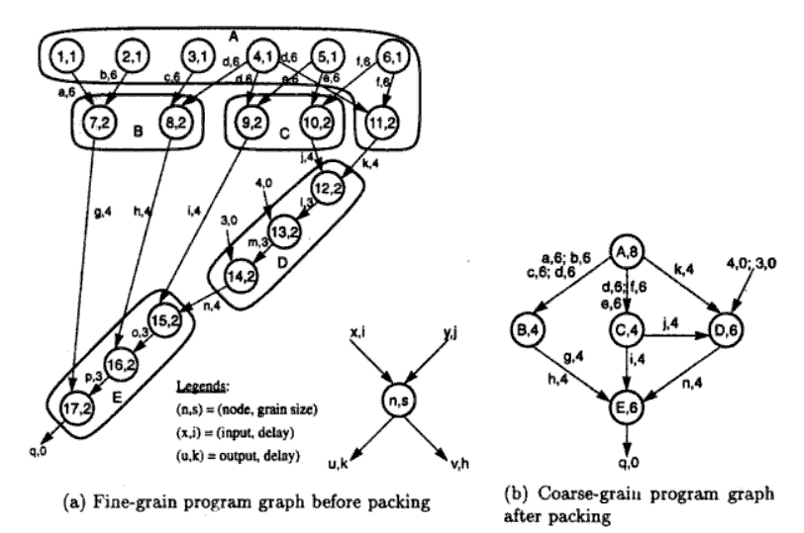
EENG-630 - Chapter 2

Slide 39
Scheduling
A schedule is a mapping of nodes to processors and start times such that communication delay requirements are observed, and no two nodes are executing on the same processor at the same time.
Some general scheduling goals
  Schedule all fine-grain activities in a node to the same processor to minimize communication delays.
  Select grain sizes for packing to achieve better schedules for a particular parallel machine.

Slide 40
Node Duplication
Grain packing may potentially eliminate interprocessor communication, but it may not always produce a shorter schedule (see figure 2.8 (a)).
By duplicating nodes (that is, executing some instructions on multiple processors), we may eliminate some interprocessor communication, and thus produce a shorter schedule.

Slide 41
Example 2.5
Example 2.5 illustrates a matrix multiplication program requiring 8 multiplications and 7 additions.
Using various approaches, the program requires:
  212 cycles (software parallelism only)
  864 cycles (sequential program on one processor)
  741 cycles (8 processors) - speedup = 1.16
  446 cycles (4 processors) - speedup = 1.94

Slide 42
Static multiprocessor scheduling
Grain packing may not be optimal
Dynamic multiprocessor scheduling is an NP-hard problem
Node duplication is a static scheme for multiprocessor scheduling
EENG-630 - Chapter 2

Slide 43
Node duplication
Duplicate some nodes to eliminate idle time and reduce communication delays
Grain packing and node duplication are often used jointly to determine the best grain size and corresponding schedule
EENG-630 - Chapter 2

Slide 44
Schedule without node duplication
P1
P2
P1
P2
A,4
4
A
I
4
a,1
a,8
6
B
B,1
C,1
I
c,1
13
12
c,8
C
14
b,1
E
D,2
E,2
16
21
20
D
23
d,4
e,4
27
EENG-630 - Chapter 2

Slide 45
Schedule with node duplication
P1
P2
P1
P2
A,4
A’,4
4
A
A
4
a,1
a,1
a,1
6
B
C
6
B,1
C’,1
C,1
7
C
c,1
E
b,1
c,1
9
10
D
D,2
E,2
13
14
EENG-630 - Chapter 2

Slide 46
Grain determination and scheduling optimization
Step 1: Construct a fine-grain program graph
Step 2: Schedule the fine-grain computation
Step 3: Grain packing to produce coarse grains
Step 4: Generate a parallel schedule based on
the packed graph
EENG-630 - Chapter 2

Slide 47
Program Flow Mechanisms
Conventional machines used control flow mechanism in which order of program execution explicitly stated in user programs.
Dataflow machines which instructions can be executed by determining operand availability.
Reduction machines trigger an instruction’s execution based on the demand for its results.

Slide 48
Control Flow vs. Data Flow
Control flow machines used shared memory for instructions and data. Since variables are updated by many instructions, there may be side effects on other instructions. These side effects frequently prevent parallel processing. Single processor systems are inherently sequential.
Instructions in dataflow machines are unordered and can be executed as soon as their operands are available; data is held in the instructions themselves. Data tokens are passed from an instruction to its dependents to trigger execution.

Slide 49
Data Flow Features
No need for
  shared memory
  program counter
  control sequencer
Special mechanisms are required to
  detect data availability
  match data tokens with instructions needing them
  enable chain reaction of asynchronous instruction execution

Slide 50
A Dataflow Architecture - 1
The Arvind machine (MIT) has N PEs and an N-by-N interconnection network.
Each PE has a token-matching mechanism that dispatches only instructions with data tokens available.
Each datum is tagged with
  address of instruction to which it belongs
  context in which the instruction is being executed
Tagged tokens enter PE through local path (pipelined), and can also be communicated to other PEs through the routing network.

Slide 51
A Dataflow Architecture - 2
Instruction address(es) effectively replace the program counter in a control flow machine.
Context identifier effectively replaces the frame base register in a control flow machine.
Since the dataflow machine matches the data tags from one instruction with successors, synchronized instruction execution is implicit.

Slide 52
A Dataflow Architecture - 3
An I-structure in each PE is provided to eliminate excessive copying of data structures.
Each word of the I-structure has a two-bit tag indicating whether the value is empty, full, or has pending read requests.
This is a retreat from the pure dataflow approach.
Example 2.6 shows a control flow and dataflow comparison.
Special compiler technology needed for dataflow machines.

Slide 53
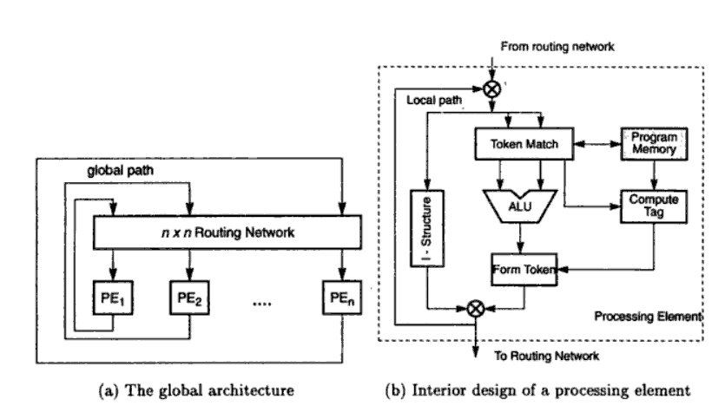
EENG-630 - Chapter 2

Slide 54
Demand-Driven Mechanisms
Data-driven machines select instructions for execution based on the availability of their operands; this is essentially a bottom-up approach.
Demand-driven machines take a top-down approach, attempting to execute the instruction (a demander) that yields the final result. This triggers the execution of instructions that yield its operands, and so forth.
The demand-driven approach matches naturally with functional programming languages (e.g. LISP and SCHEME).

Slide 55
Reduction Machine Models
String-reduction model:
  each demander gets a separate copy of the expression string to evaluate
  each reduction step has an operator and embedded reference to demand the corresponding operands
  each operator is suspended while arguments are evaluated
Graph-reduction model:
  expression graph reduced by evaluation of branches or subgraphs, possibly in parallel, with demanders given pointers to results of reductions.
  based on sharing of pointers to arguments; traversal and reversal of pointers continues until constant arguments are encountered.

Slide 56
System Interconnect Architectures
Direct networks for static connections
Indirect networks for dynamic connections
Networks are used for
  internal connections in a centralized system among
    processors
    memory modules
    I/O disk arrays
  distributed networking of multicomputer nodes

Slide 57
Goals and Analysis
The goals of an interconnection network are to provide
  low-latency
  high data transfer rate
  wide communication bandwidth
Analysis includes
  latency
  bisection bandwidth
  data-routing functions
  scalability of parallel architecture

Slide 58
Network Properties and Routing
Static networks: point-to-point direct connections that will not change during program execution
Dynamic networks:
  switched channels dynamically configured to match user program communication demands
  include buses, crossbar switches, and multistage networks
Both network types also used for inter-PE data routing in SIMD computers

Slide 59
Network Parameters
Network size: The number of nodes in the graph used to represent the network
Node Degree d: The number of edges incident to a node. Sum of in degree and out degree
Network Diameter D: The maximum shortest path between any two nodes
EENG-630 - Chapter 2

Slide 60
Network Parameters (cont.)
Bisection Width:
  Channel bisection width b: The minimum number of edges along the cut that divides the network in two equal halves
  Each channel has w bit wires
  Wire bisection width: B=b*w; B is the wiring density of the network. It provides a good indicator of tha max communication bandwidth along the bisection of the network
EENG-630 - Chapter 2

Slide 61
Terminology - 1
Network usually represented by a graph with a finite number of nodes linked by directed or undirected edges.
Number of nodes in graph = network size .
Number of edges (links or channels) incident on a node = node degree d (also note in and out degrees when edges are directed). Node degree reflects number of I/O ports associated with a node, and should ideally be small and constant.
Diameter D of a network is the maximum shortest path between any two nodes, measured by the number of links traversed; this should be as small as possible (from a communication point of view).

Slide 62
Terminology - 2
Channel bisection width b = minimum number of edges cut to split a network into two parts each having the same number of nodes. Since each channel has w bit wires, the wire bisection width B = bw. Bisection width provides good indication of maximum communication bandwidth along the bisection of a network, and all other cross sections should be bounded by the bisection width.
Wire (or channel) length = length (e.g. weight) of edges between nodes.
Network is symmetric if the topology is the same looking from any node; these are easier to implement or to program.
Other useful characterizing properties: homogeneous nodes? buffered channels? nodes are switches?

Slide 63
Data Routing Functions
Shifting
Rotating
Permutation (one to one)
Broadcast (one to all)
Multicast (many to many)
Personalized broadcast (one to many)
Shuffle
Exchange
Etc.

Slide 64
Permutations
For n objects there are n! permutations by which the n objects can be reordered.The set of all permutations form a permutation group with respect to a composition operation. Cycle notation can be used to specify a permutation operation.
Permutation π = (a, b, c)(d, e) means: a->b, b->c, c->a, d->e and e->d in a circular fashion. The cycle (a, b, c) has a period of 3, and the cycle (d, e) has a period of 2. π will have a period equal to 2 x 3 = 6.
EENG-630 - Chapter 2

Slide 65
Permutations (cont.)
Can be implemented using crossbar switches, multistage networks or with shifting or broadcast operations.
Permutation capability is an indication of network’s data routing capabilities
EENG-630 - Chapter 2

Slide 66
Perfect Shuffle and Exchange
Stone suggested the special permutation that entries according to the mapping of the k-bit binary number a b … k to b c … k a (that is, shifting 1 bit to the left and wrapping it around to the least significant bit position).
The inverse perfect shuffle reverses the effect of the perfect shuffle.

Slide 67
Perfect Shuffle
Special permutation function
n = 2^{k} objects; each object representation requires k bits
Perfect shuffle maps x to y where:
  x = ( x_{k-1}, …, x₁, x₀ )
  y = ( x_{k-2}, …, x₁, x₀, x_{k-1} )
EENG-630 - Chapter 2

Slide 68
Exchange
n = 2^{k} objects; each object representation requires k bits
The exchange maps x to y where:
  x = ( x_{k-1}, …, x₁, x₀ )
  y = ( x_{k-1}, …, x₁, x₀’ )
Hypercube routing functions are exchanges
EENG-630 - Chapter 2

Slide 69
Hypercube Routing Functions
If the vertices of a n-dimensional cube are labeled with n-bit numbers so that only one bit differs between each pair of adjacent vertices, then n routing functions are defined by the bits in the node (vertex) address.
For example, with a 3-dimensional cube, we can easily identify routing functions that exchange data between nodes with addresses that differ in the least significant, most significant, or middle bit.

Slide 70
Broadcast and Multicast
Broadcast: One-to-all mapping
Multicast: one subset to another subset
Personalized Broadcast: Personalized messages to only selected receivers
EENG-630 - Chapter 2

Slide 71
Network Performance
Functionality
Network latency
Bandwidth
Hardware complexity
Scalability
EENG-630 - Chapter 2

Slide 72
Factors Affecting Performance
Functionality – how the network supports data routing, interrupt handling, synchronization, request/message combining, and coherence
Network latency – worst-case time for a unit message to be transferred
Bandwidth – maximum data rate
Hardware complexity – implementation costs for wire, logic, switches, connectors, etc.
Scalability – how easily does the scheme adapt to an increasing number of processors, memories, etc.?

Slide 73
Static Networks
Linear Array
Ring and Chordal Ring
Barrel Shifter
Tree and Star
Fat Tree
Mesh and Torus

Slide 74
Static Networks – Linear Array
N nodes connected by n-1 links (not a bus); segments between different pairs of nodes can be used in parallel.
Internal nodes have degree 2; end nodes have degree 1.
Diameter = n-1
Bisection = 1
For small n, this is economical, but for large n, it is obviously inappropriate.

Slide 75
Static Networks – Ring, Chordal Ring
Like a linear array, but the two end nodes are connected by an n ^{th} link; the ring can be uni- or bi-directional. Diameter is ⎣n/2⎦ for a bidirectional ring, or n for a unidirectional ring.
By adding additional links (e.g. “chords” in a circle), the node degree is increased, and we obtain a chordal ring. This reduces the network diameter.
In the limit, we obtain a fully-connected network, with a node degree of n -1 and a diameter of 1.

Slide 76
Static Networks – Barrel Shifter
Like a ring, but with additional links between all pairs of nodes that have a distance equal to a power of 2.
With a network of size N = 2n, each node has degree d = 2n -1, and the network has diameter D = n /2.
Barrel shifter connectivity is greater than any chordal ring of lower node degree.
Barrel shifter much less complex than fully-interconnected network.

Slide 77
Static Networks – Tree and Star
A k-level completely balanced binary tree will have N = 2k – 1 nodes, with maximum node degree of 3 and network diameter is 2(k – 1).
The balanced binary tree is scalable, since it has a constant maximum node degree.
A star is a two-level tree with a node degree d = N – 1 and a constant diameter of 2.

Slide 78
Static Networks – Fat Tree
A fat tree is a tree in which the number of edges between nodes increases closer to the root (similar to the way the thickness of limbs increases in a real tree as we get closer to the root).
The edges represent communication channels (“wires”), and since communication traffic increases as the root is approached, it seems logical to increase the number of channels there.

Slide 79
Static Networks – Mesh and Torus
Pure mesh – N = n ^{k} nodes with links between each adjacent pair of nodes in a row or column (or higher degree). This is not a symmetric network; interior node degree d = 2k, diameter = k (n – 1).
Illiac mesh (used in Illiac IV computer) – wraparound is allowed, thus reducing the network diameter to about half that of the equivalent pure mesh.
A torus has ring connections in each dimension, and is symmetric. An n × n binary torus has node degree of 4 and a diameter of 2 × ⎣n / 2⎦ .

Slide 80
Static Networks – Systolic Array
A systolic array is an arrangement of processing elements and communication links designed specifically to match the computation and communication requirements of a specific algorithm (or class of algorithms).
This specialized character may yield better performance than more generalized structures, but also makes them more expensive, and more difficult to program.

Slide 81
Static Networks – Hypercubes
A binary n-cube architecture with N = 2^{n} nodes spanning along n dimensions, with two nodes per dimension.
The hypercube scalability is poor, and packaging is difficult for higher-dimensional hypercubes.

Slide 82
Static Networks – Cube-connected Cycles
k-cube connected cycles (CCC) can be created from a k-cube by replacing each vertex of the k-dimensional hypercube by a ring of k nodes.
A k-cube can be transformed to a k-CCC with k × 2^{k} nodes.
The major advantage of a CCC is that each node has a constant degree (but longer latency) than in the corresponding k-cube. In that respect, it is more scalable than the hypercube architecture.

Slide 83
Static Networks – k-ary n-Cubes
Rings, meshes, tori, binary n-cubes, and Omega networks (to be seen) are topologically isomorphic to a family of k-ary n-cube networks.
n is the dimension of the cube, and k is the radix, or number of of nodes in each dimension.
The number of nodes in the network, N, is k ^{n}.
Folding (alternating nodes between connections) can be used to avoid the long “end-around” delays in the traditional implementation.

Slide 84
Static Networks – k-ary n-Cubes
The cost of k-ary n-cubes is dominated by the amount of wire, not the number of switches.
With constant wire bisection, low-dimensional networks with wider channels provide lower latecny, less contention, and higher “hot-spot” throughput than higher-dimensional networks with narrower channels.

Slide 85
Network Throughput
Network throughput – number of messages a network can handle in a unit time interval.
One way to estimate is to calculate the maximum number of messages that can be present in a network at any instant (its capacity); throughput usually is some fraction of its capacity.
A hot spot is a pair of nodes that accounts for a disproportionately large portion of the total network traffic (possibly causing congestion).
Hot spot throughput is maximum rate at which messages can be sent between two specific nodes.

Slide 86
Minimizing Latency
Latency is minimized when the network radix k and dimension n are chose so as to make the components of latency due to distance (# of hops) and the message aspect ratio L / W (message length L divided by the channel width W ) approximately equal.
This occurs at a very low dimension. For up to 1024 nodes, the best dimension (in this respect) is 2.

Slide 87
Dynamic Connection Networks
Dynamic connection networks can implement all communication patterns based on program demands.
In increasing order of cost and performance, these include
  bus systems
  multistage interconnection networks
  crossbar switch networks
Price can be attributed to the cost of wires, switches, arbiters, and connectors.
Performance is indicated by network bandwidth, data transfer rate, network latency, and communication patterns supported.

Slide 88
Dynamic Networks – Bus Systems
A bus system (contention bus, time-sharing bus) has
  a collection of wires and connectors
  multiple modules (processors, memories, peripherals, etc.) which connect to the wires
  data transactions between pairs of modules
Bus supports only one transaction at a time.
Bus arbitration logic must deal with conflicting requests.
Lowest cost and bandwidth of all dynamic schemes.
Many bus standards are available.

Slide 89
Dynamic Networks – Switch Modules
An a × b switch module has a inputs and b outputs. A binary switch has a = b = 2.
It is not necessary for a = b, but usually a = b = 2^{k}, for some integer k.
In general, any input can be connected to one or more of the outputs. However, multiple inputs may not be connected to the same output.
When only one-to-one mappings are allowed, the switch is called a crossbar switch.

Slide 90
Multistage Networks
In general, any multistage network is comprised of a collection of a × b switch modules and fixed network modules. The a × b switch modules are used to provide variable permutation or other reordering of the inputs, which are then further reordered by the fixed network modules.
A generic multistage network consists of a sequence alternating dynamic switches (with relatively small values for a and b) with static networks (with larger numbers of inputs and outputs). The static networks are used to implement interstage connections (ISC).

Slide 91
Omega Network
A 2 × 2 switch can be configured for
  Straight-through
  Crossover
  Upper broadcast (upper input to both outputs)
  Lower broadcast (lower input to both outputs)
  (No output is a somewhat vacuous possibility as well)
With four stages of eight 2 × 2 switches, and a static perfect shuffle for each of the four ISCs, a 16 by 16 Omega network can be constructed (but not all permutations are possible).
In general , an n-input Omega network requires log ₂ n stages of 2 × 2 switches and n / 2 switch modules.

Slide 92
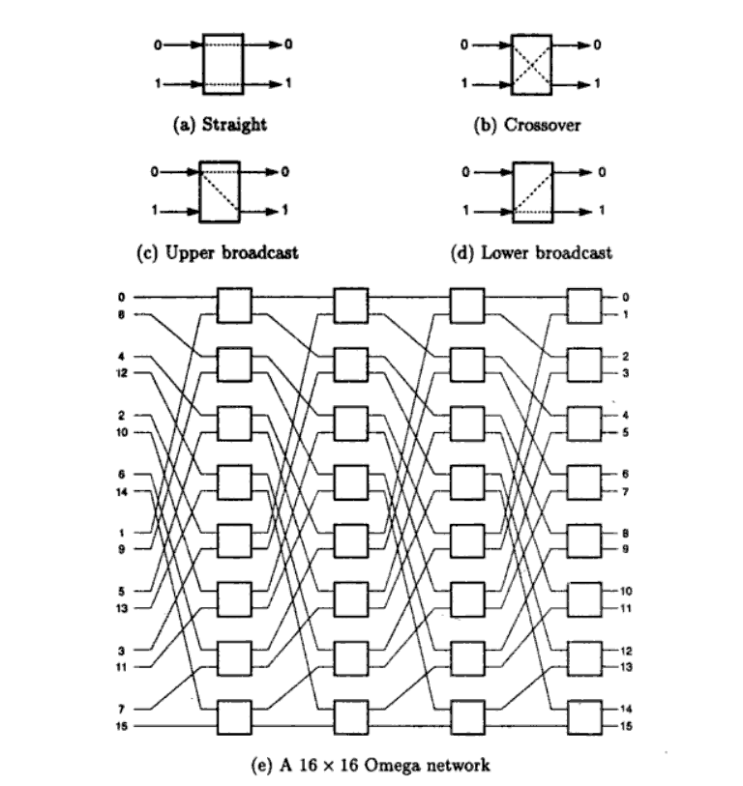
EENG-630 - Chapter 2

Slide 93
Baseline Network
A baseline network can be shown to be topologically equivalent to other networks (including Omega), and has a simple recursive generation procedure.
Stage k (k = 0, 1, …) is an m × m switch block (where m = N / 2^{k} ) composed entirely of 2 × 2 switch blocks, each having two configurations: straight through and crossover.

Slide 94
4 × 4 Baseline Network

Slide 95
Crossbar Networks
A m × n crossbar network can be used to provide a constant latency connection between devices; it can be thought of as a single stage switch.
Different types of devices can be connected, yielding different constraints on which switches can be enabled.
  With m processors and n memories, one processor may be able to generate requests for multiple memories in sequence; thus several switches might be set in the same row.
  For m × m interprocessor communication, each PE is connected to both an input and an output of the crossbar; only one switch in each row and column can be turned on simultaneously. Additional control processors are used to manage the crossbar itself.

